Slide 1
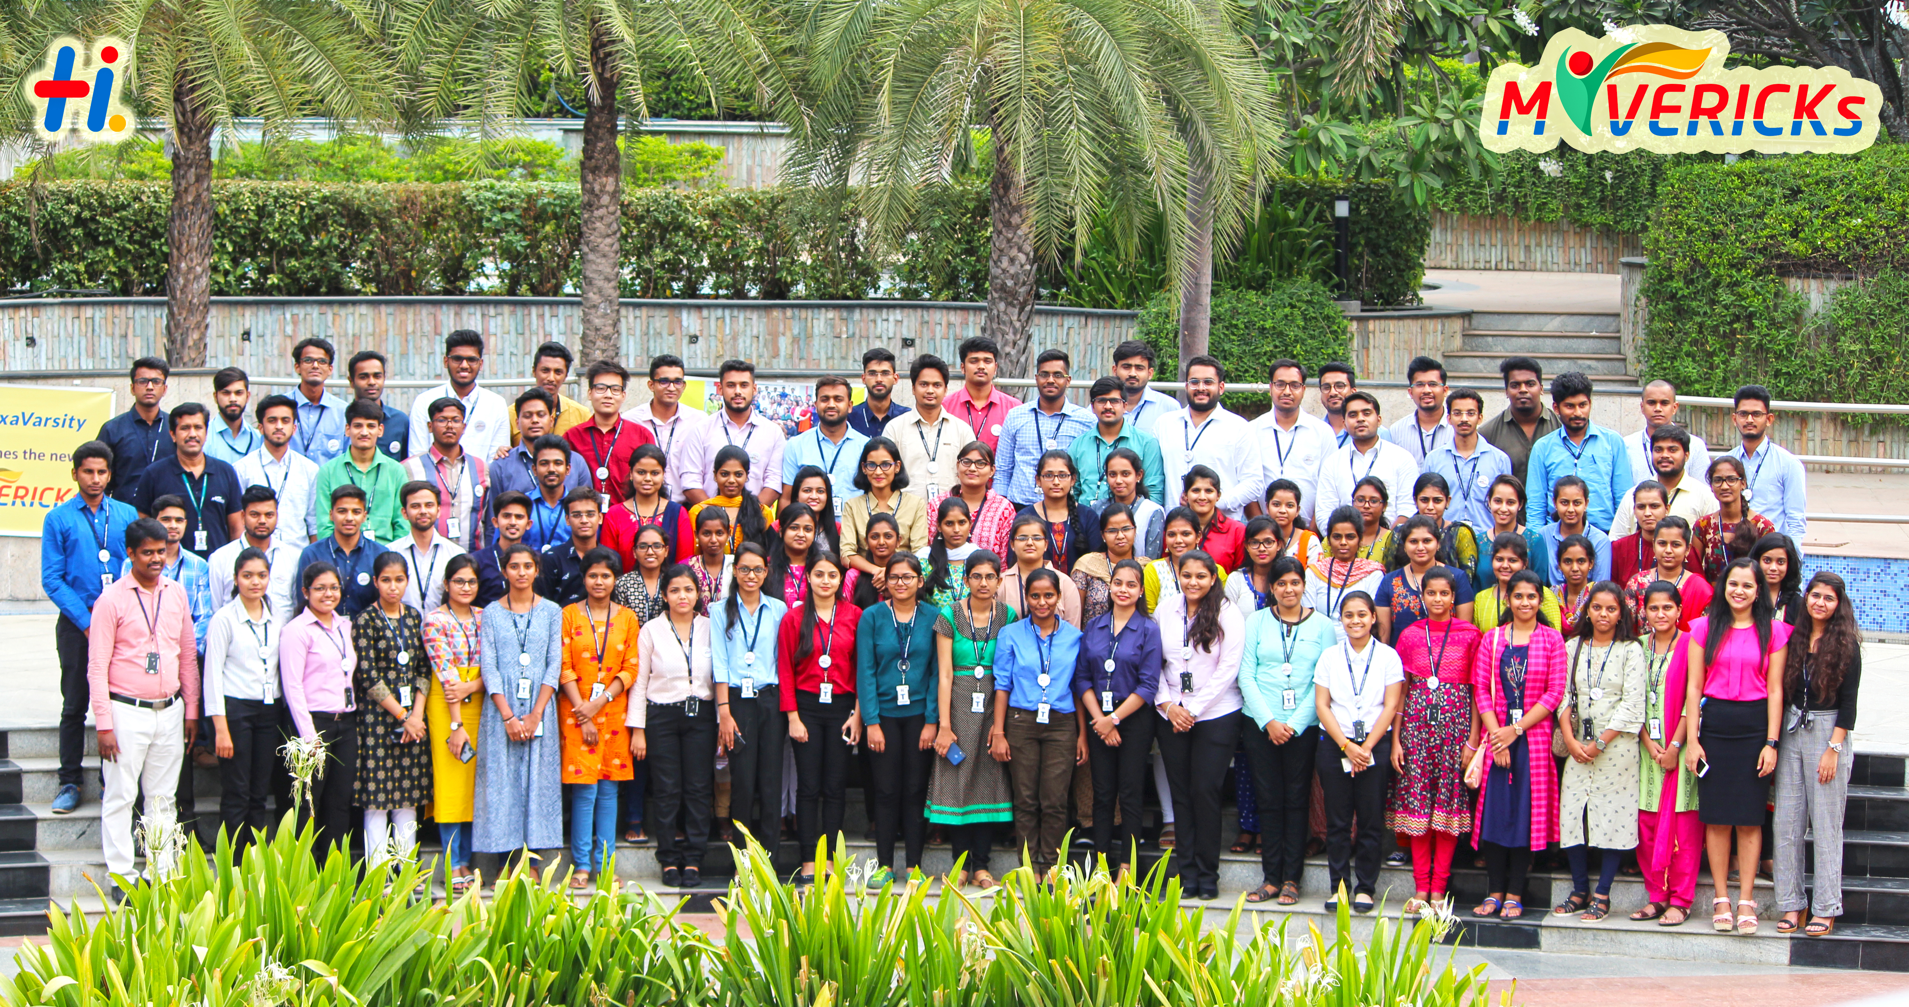
Foundation: Full Stack Training Overview

Slide 2
Full Stack Development Architecture
Project
Management
User Interaction
Core System
Testing
Presentation
SCCS - Git / AWS CodeCommit
ALM - Trello
DevOps - Jenkins
Browser
Ng Templates
Selenium/ Protractor
Ng Components
Jasmine/
Karma
Ng Services
Business Logic
Curl
Jersey
RestAssured
Terminal
Cli
Junit/JMockit
Java
JDBI
Persistence
MySQL Workbench
MySQL

Slide 3
Topics
SCCS - Git / AWS CodeCommit
Unix Command Line
Agile
ALM - Trello
Multi-Tier systems
Week #1
Project
Management
User Interaction
Core System
Testing
Presentation
SCCS - Git / AWS CodeCommit
ALM - Trello
DevOps - Jenkins
Browser
Ng Templates
Selenium/ Protractor
Ng Components
Jasmine/
Karma
Ng Services
Business Logic
Curl
Jersey
RestAssured
Terminal
Cli
Junit/JMockit
Java
JDBI
Persistence
MySQL Workbench
MySQL

Slide 4
Week #2
Topics
RDBMS
MySQL
MySQL Workbench
Project
Management
User Interaction
Core System
Testing
Presentation
SCCS - Git / AWS CodeCommit
ALM - Trello
DevOps - Jenkins
Browser
Ng Templates
Selenium/ Protractor
Ng Components
Jasmine/
Karma
Ng Services
Business Logic
Curl
Jersey
RestAssured
Terminal
Cli
Junit/JMockit
Java
JDBI/JDBC
Persistence
MySQL Workbench
MySQL

Slide 5
Topics
Java
JDBI/JDBC
Junit/JMockit
Week #3
Project
Management
User Interaction
Core System
Testing
Presentation
SCCS - Git / AWS CodeCommit
ALM - Trello
DevOps - Jenkins
Browser
Ng Templates
Selenium/ Protractor
Ng Components
Jasmine/
Karma
Ng Services
Business Logic
Curl
Jersey
RestAssured
Terminal
Cli
Junit/JMockit
Java
JDBI/JDBC
Persistence
MySQL Workbench
MySQL

Slide 6
Week #4
Topics
Java
JDBI/JDBC
Junit/JMockit
Project
Management
User Interaction
Core System
Testing
Presentation
SCCS - Git / AWS CodeCommit
ALM - Trello
DevOps - Jenkins
Browser
Ng Templates
Selenium/ Protractor
Ng Components
Jasmine/
Karma
Ng Services
Business Logic
Curl
Jersey
RestAssured
Terminal
Cli
Junit/JMockit
Java
JDBI/JDBC
Persistence
MySQL Workbench
MySQL

Slide 7
Topics
HTML
CSS
Typescript
Angular
Modules
Components
Templates
Router
Week #5
Project
Management
User Interaction
Core System
Testing
Presentation
SCCS - Git / AWS CodeCommit
ALM - Trello
DevOps - Jenkins
Browser
Ng Templates
Selenium/ Protractor
Ng Components
Jasmine/
Karma
Ng Services
Business Logic
Curl
Jersey
RestAssured
Terminal
Cli
Junit/JMockit
Java
JDBI/JDBC
Persistence
MySQL Workbench
MySQL

Slide 8
Topics
CI/CD
Jenkins
Docker
Operability
ELK
Metrics, Monitoring
Alerts, Dashboards
Responsive Design
Bootstrap
Bulma
Mobile Frameworks
Ionic
Cordova
React Native
Conversational Interfaces
Chatbots
Voicebots
NoSQL Datastores
MongoDB
Project
Management
User Interaction
Core System
Testing
Presentation
SCCS - Git / AWS CodeCommit
ALM - Trello
DevOps - Jenkins
Browser
Ng Templates
Selenium/ Protractor
Ng Components
Jasmine/
Karma
Ng Services
Business Logic
Curl
Jersey
RestAssured
Terminal
Cli
Junit/JMockit
Java
JDBI
Persistence
MySQL Workbench
MySQL

Slide 9
The goal is NOT to teach technologies
An environment where you self-learn
Mentors you can seek help from
Peers you can exchange ideas with
Problems you need to solve
Concepts you need to learn

Slide 10
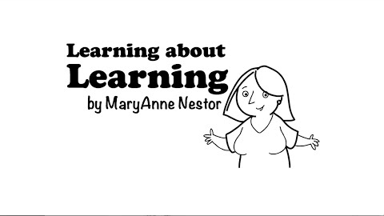
Learning to Learn
‘Melt & Mould’

Slide 11
Practical and Conceptual Knowledge
Programming Languages
Java, TypeScript
DB, API, UI
Requirements, Design, Implementation, and Testing
Agile:
Incremental Delivery
Working in a team
Design Patterns: Layered Systems, API-based Design, Client-Side MVC

Slide 12

Learn By Doing
“General Principles from Particular Instances” : Inductive Learning

Slide 13
What is “professional” behavior?
Do your homework
Straight & Upright
Presentation skills
Persuasion skills
Question Everything

Slide 14
What we need
Not a 9-5 course
Not a passive course
Put life on ‘pause’
Treat the faculty as your friends
Provide constant feedback

Slide 15
Work Hard, Play Hard
Don’t “time pass”

Slide 16
Learning and Productivity Hacks
Feedback
Working Code
Pull Request Review by mentors
Sprint Review/Retrospective
Metacognition
Sprint planning
Daily Standup
Task Breakdown
Sane Expectations
Little Rewards
Spaced Repetition
Interleaving
Cheat Sheets
Pomodoro Technique
Exercise
Sleep, Dream

Slide 17
Mechanics
Workshop-centric model
Morning: Classrooms & Hands-on sessions
Afternoon: Work as team
Team-based course: 5 weekly sprints
Presentations
On design decisions
On technical topics
Reading Material
Evaluation
Delivered Product
Peer Ratings: Helpfulness, Hard-working, Knowledgeable, …
Tests: Concepts/Practical Knowledge, beyond what is taught in class
Allocation to Competency as per your performance in this course

Slide 18
Facebook Feed:
TechCrunch
WIRED
MIT Technology Review
The Verge
ARS Technica
Online Courseware
Edx
Coursera
Udacity
Udemy
Codecademy
Khan Academy

Slide 19
Links:
https://www.coursera.org/learn/learning-how-to-learn
https://hbr.org/2018/05/learning-is-a-learned-behavior-heres-how-to-get-better-at-it
https://dev.to/nextdotxyz/this-picture-will-change-the-way-you-learn-tocode-4kmh
https://blog.hubstaff.com/how-to-get-into-the-flow-mode/
https://medium.com/the-crossover-cast/get-better-at-anything-6-steps-of-deliberate-practice-19830bfc9460
https://medium.com/@flaviorump/systems-vs-goals-a67fcd937370
Hackathons/Code Competitions
TopCoder
Hacker Earth
Kaggle
Project Euler

Slide 20
Best Of Luck

